Slide 1
Python and SQLite tutorial
Cheng Nie
Spring 2018
chengnie.com
Version: fall, 2018

Slide 2

Motivation
Star Wars special effect team use Python to glue tools using various programming languages

Slide 3
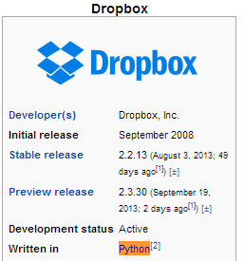
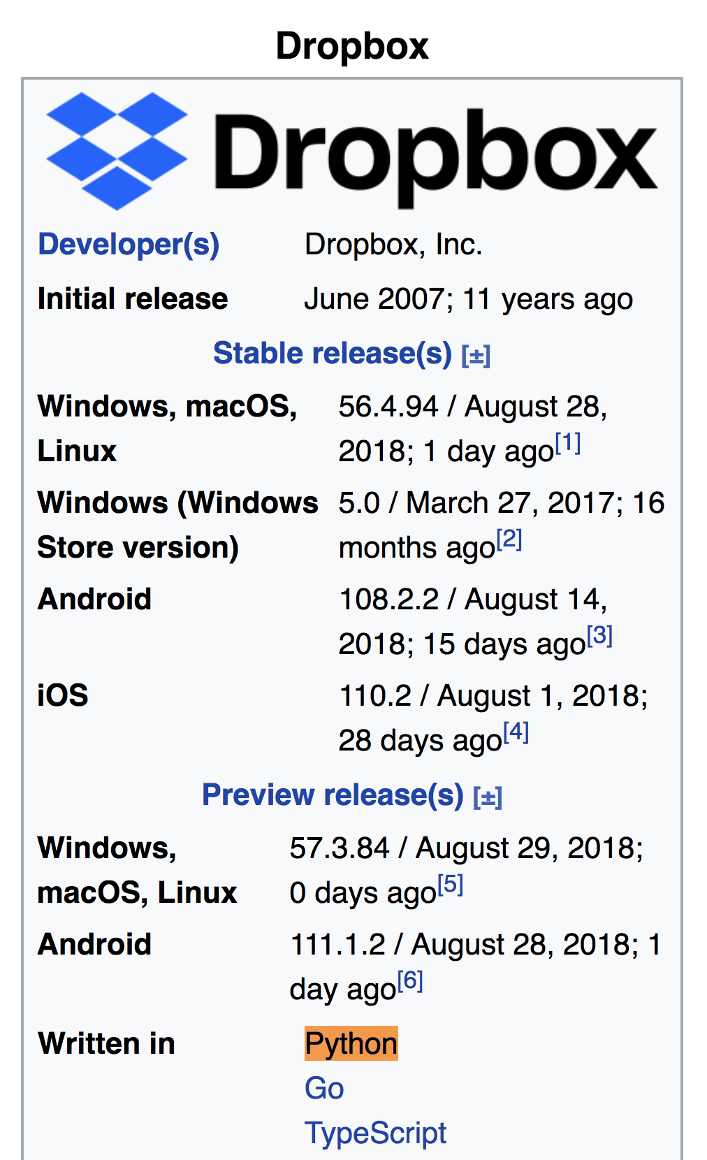
Motivation

Slide 4
Outline
Python
Installation
Python
Basic Intro
Variables and operators
Control flow
if/else; while; for
Data Structure
list, tuple, dictionary
SQL
Installation
Create, populate, and query tables
Fetching data from yelp.com

Slide 5
Why Python?
It’s open source software
Free to use
Source code is accessible
Online community is huge
Platform independent
Powerful
Dynamic typing (check type at run time)
Built-in types and functions
Library utilities
Third party utilities (scikit-learn, SciPy, NumPy)
Automatic memory management

Slide 6
Installation
Jupyter (IPython) Notebook by installing Anaconda
Integrated Development Environment (IDE) PyCharm
We will be using Python 3.6 and Notebook for this course

Slide 7
Python tutorial
Numbers
Strings
List
Tuple
Dictionary
Control of flow

Slide 8
Numbers
No need to specify the variable type before using it
The equal sign ('=') is used to assign a value to a variable
the last printed expression is assigned to the variable _

Slide 9
Strings
Enclosed in single quotes, double quotes, triple quotes.
Index and slice of strings.

Slide 10
comparison operators
< (less than)
> (greater than)
== (equal to)
<= (less than or equal to)
>= (greater than or equal to)
!= (not equal to)

Slide 11
Built-in Data Type: List
Comma-separated items between square brackets
List items need not all have the same type
Mutable elements
Very versatile

Slide 12
Built-in Data Types other than list
tuple: Similar to list, but immutable
dict: unordered set of {key: value} pairs

Slide 13
Control flow
if
while
for

Slide 14
Indentation v.s. {}
Indentation is Python’s way of grouping statements, no more {}
As long as it’s consistent in the program, Python interpreter can understand it. It can be at least one space, or at least one tab (4 spaces is preferred)

Slide 15
Function
Define and use a function
Fibonacci series up to n

Slide 16
Example of scraping Yelp.com
UTD is reviewed on Yelp.com
Get the individual review’s rating and date

Slide 17
SQL
Install SQLite following the instructions on the Jupyter Notebook.

Slide 18
Access tables
Database -> Table
Create database test
Choose this database by using “use” command
Create table to store data.

Slide 19
create table example(
id int not null,
name varchar(30),
age tinyint,
primary key(id));
The word "example" is the name of our table, as it came directly after "CREATE TABLE". It is a good idea to use descriptive names when creating a table, such as: employee_information, contacts, or customer_orders. Clear names will ensure that you will know what the table is about when revisiting it a year after you make it.

Slide 20
create table example(
id int not null,
name varchar(30),
age tinyint,
primary key(id));
Here we create a column "id" that is not null and belongs to int data type.

Slide 21
create table example(
id int not null,
name varchar(30),
age tinyint,
primary key(id));
Reserved MySQL Keywords: Here are a few quick definitions of the reserved words used in this line of code:
INT - This stands for integer or whole number. 'id' has been defined to be an integer.
NOT NULL - These are actually two keywords, but they combine together to say that this column cannot be null. An entry is NOT NULL only if it has some value, while something with no value is NULL.

Slide 22
create table example(
id int not null,
name varchar(30),
age tinyint,
primary key(id));
Here we make a new column with the name "name"! VARCHAR stands for "variable character". "Character" means that you can put in any kind of typed information in this column (letters, numbers, symbols, etc). It's "variable" because it can adjust its size to store as little as 0 characters and up to a specified maximum number of characters.
We will most likely only be using this name column to store characters (A-Z, a-z). The number inside the parentheses sets the maximum number of characters. In this case, the max is 30.

Slide 23
create table example(
id int not null,
name varchar(30),
age tinyint,
primary key(id));
Our third and final column is age, which stores an tiny integer. The possible integer values that can be stored in an “TINYINT" are -128 to 127, which is enough to store someone's age.
Notes:
Tinyint unsigned

Slide 24
create table example(
id int not null,
name varchar(30),
age tinyint,
primary key(id));
PRIMARY KEY is used as a unique identifier for the rows. Here we have made "id" the PRIMARY KEY for this table. This means that no two ids can be the same, or else we will run into trouble.

Slide 25
Import data
Import text file into database for processing
Query data

Slide 26
Regular Expression
Basic element for crawling data from websites
Match a pattern to a string for further processing:
Match
Change

Slide 27
Basic components
Metacharacter | Description
\t | tab
+ | Matches the preceding pattern element one or more times
\d | Matches a digit
[…] | Denotes a set of possible character matches.
() | Groups a series of pattern elements to a single element

Slide 28
Examples
Space
Digits

Slide 29
More about index
step not equal to 1
negative index

Slide 30
More about List
map function
list comprehension

